Slide 1
FWD Project
TOGAF 9 - Core Diagrams
Business Services and Information Diagram
Phase B – Business Architecture

Slide 2
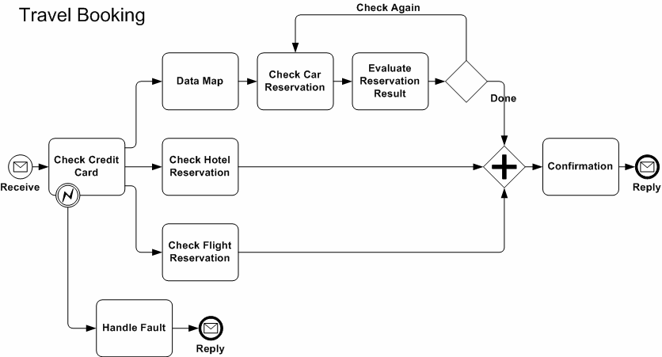
Business Services and Information Diagram

Slide 3
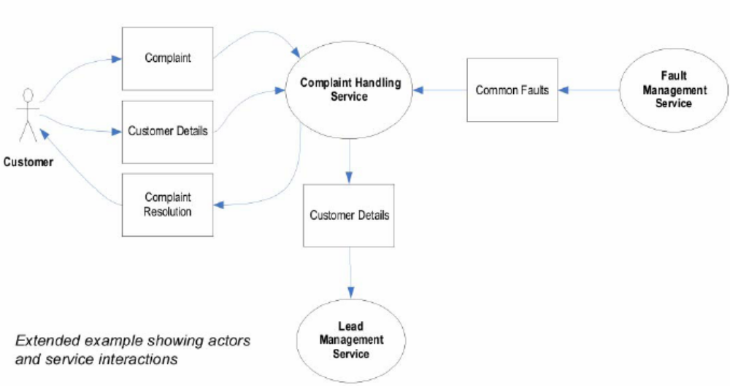
Business Services and Information Diagram

Slide 4
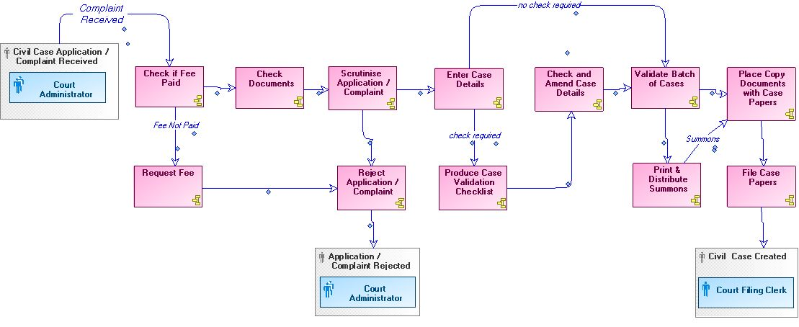
Business Services and Information Diagram

